Slide 1

Transcription
Shuzan Ali Mohammed, MD
Lecturer of Medical Biochemistry
Shuzan.ali@fmed.bu.edu.eg
http://www.bu.edu.eg/staff/shuzanali12
Shuzan Ali

Slide 2
Gene expression
The gene (DNA) undergoing transcription into mRNA that translate the encoded genetic information into protein
Transcription (RNA synthesis)
By DNA – dependent RNA polymerase (using DNA as a template)
Features of transcription:
*One of 2 DNA strands is transcribed (template or anti-sense).
(templete strand sequence is complement. to mRNA transcriped).
* The other strand (non-transcribed); (coding or sense); has the same sequence as the synthesized RNA (except T →U)
* DNA template strand is read in 3' to 5' direction by RNA polymerase & RNA is synthesized in 5' to 3' direction.
* A transcriptional unit is the segment of DNA between specific initiation & termination sequences (produces 1^{ry} transcript).

Slide 3
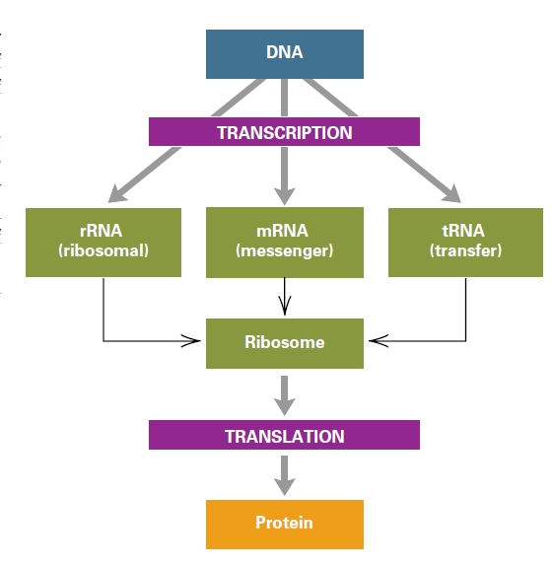
snRNA
80%
5%
15%

Slide 4
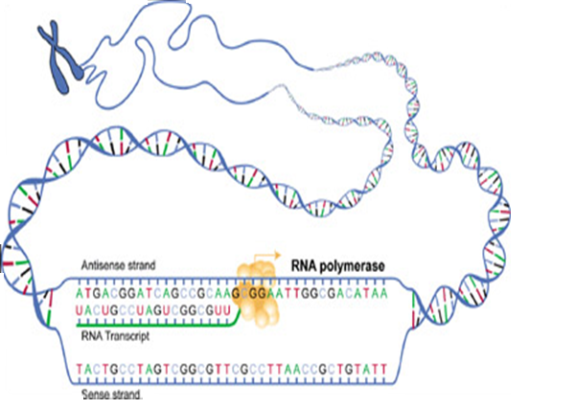
(Template)
3'
5'
5'
3'
5'
3'
(Coding)

Slide 5
Replication Versus Transcription
Point | Replication | Transcription
Definition | Synthesis of DNA | Synthesis of RNA
Gene copied | Both strands are replicated (All genes) | Only the template strand is transcribed (Selected genes)
Polymerase | DNA polymerase | RNA polymerase
Primer | Need a primer | No primer
Proofreading | Present | Absent
Postsynthesis modification | Limited (only methylation) | Numerous mRNA: cap, tail, splicing rRNA: subunit format. (40S & 60S) tRNA: removal of 5' leader sequence Addition of 3' CCA Chemical alteration of bases Excision of intron in anticodon loop

Slide 6
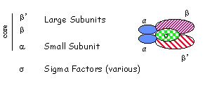
prokaryotic RNA polymerase
(multi-subunit enzyme)
* Core enzyme
lacks specificity
2 identical
α subunits
2 non identical β & β'subunits
** Sigma “σ” factor
binds DNA
phosphodiester bond formation
recognize the promoter on DNA
*Core Enz. cannot recognize promoter on DNA
σ factor + core E → holoenzyme (recognize)
**Different σ factors for different promotors
***Rifampicin binds RNA polymerase β sub → inhibits RNA synthesis in prokary.→ antibiotic
***

Slide 7
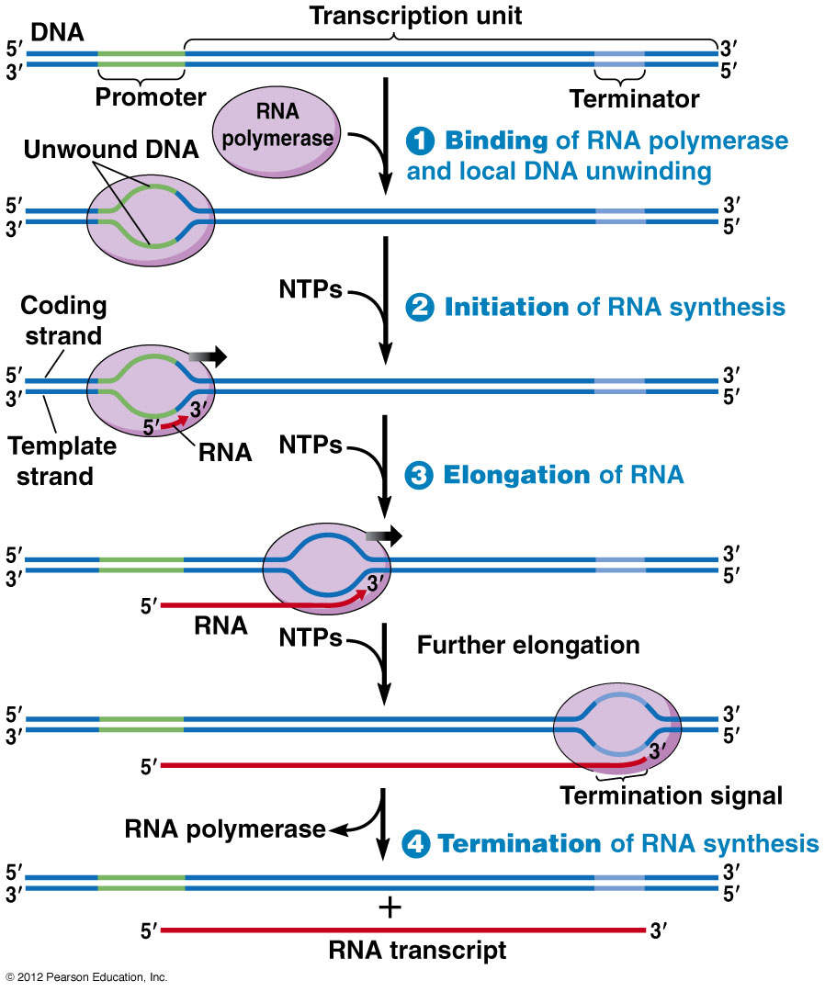
Prokaryotes Transcription
Binding
Elongation
Termination
Initiation
All types of prok. RNA is synthesized by a specific enzyme called RNA polymerase except for short RNA primers needed for DNA replication are synthesized by a primase enzyme.

Slide 8
Initiation
1. Sigma factor (σ) binds to the promoter at the TATA box
2. RNA polymerase starts transcription at the start point (+1),
the first base transcribed as RNA.
Prokaryote promoter contains 2 regions
TATA box: 6 N. (TATAAT)
10 bases
upstream to (+1)
determines where transcription starts (recognized by σ factor)
TTGACA box
35 bases
upstream to (+1)
determines the transcription frequency

Slide 9
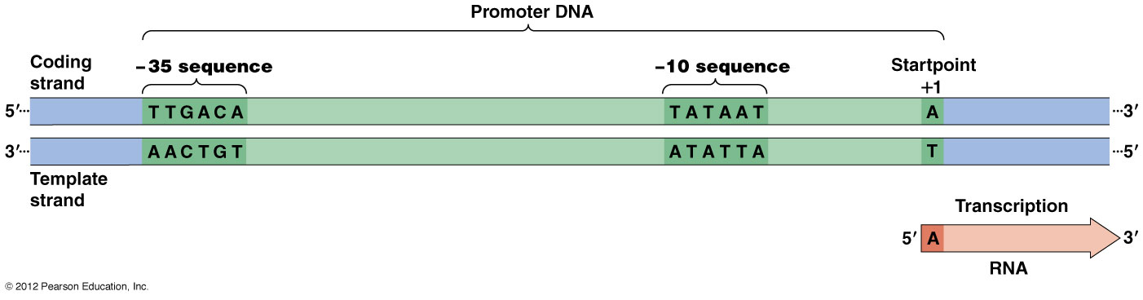
upstream
downstream
sense
antisense
Initiation

Slide 10
Elongation
Only one RNA polymerase synthesizes all prokaryotic RNA (except for short RNA primers needed for DNA replication are synthesized by a primase enzyme).
Binding → unwinding of DNA double helix to expose the bases
Unwinding generates supercoils released by topoisomerase I & II.
The enzyme synthesize RNA in 5‘ → 3' direction with bases complementary to that of DNA template strand.
Sigma factor is released after initiation of transcription.
The core enzyme moves along DNA template uses NTPs (ATP, GTP, CTP & UTP) and releases pyrophosphate
RNA polymerase has no proofreading activity so the addition of wrong base is common but not so harmful as in DNA because it is not permanent and not transfer to other cells

Slide 11
Termination
RNA polymerase recognizes termination signal at the end of the DNA sequence to be transcribed so it releases RNA molecule.
2 Termination Mechanisms
Rho factor dep.
(ATP dependent)
rho factor (ρ) protein
binds to a specific terminat. sequence & has ATP-depend. DNA-RNA helicase activity
Rho factor independent
hairpin loop
self-complement. terminat. sequences rich in GC at 3' end of mRNA
RNA pol. Pause → disrupt. of DNA-RNA hybrid

Slide 12
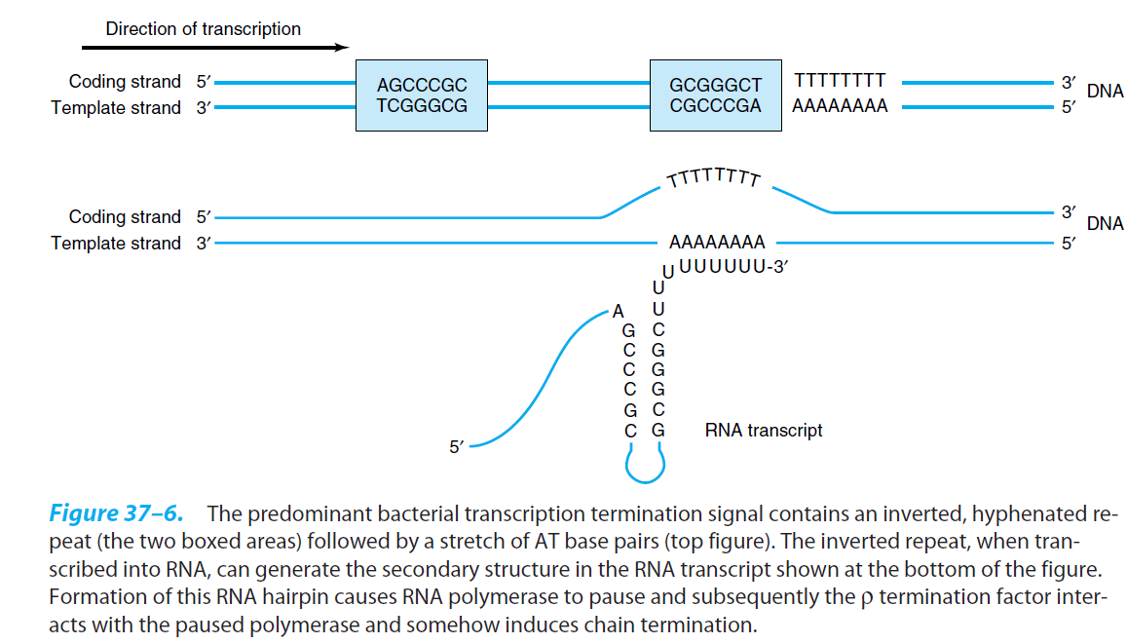
Hairpin termination

Slide 13
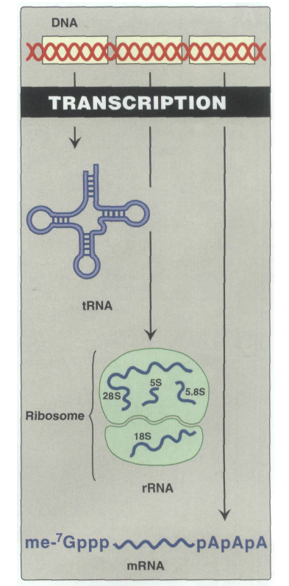

Slide 14
Transcription in Eukaryotes
Transcription of eukaryotic genes is more complicated:
Prokary. mRNA (polycistronic) [information of > 1 gene] but
Eukary. mRNA (monocistronic) [information of 1 gene only].
Eukaryotic RNA polymerases: RNA pol I, II, III & Mit. RNA p
Type | Product
RNA pol I | Transcribes rRNA (18S, 5.8 S, 28 S)
RNA pol II* | Transcribes mRNA & most snRNAs
RNA pol III | Transcribes tRNA & 5 S rRNA
Mitochondrial RNA | Resembles bacterial RNA pol. > eukary. E
Alfa (a) amantin*: a potent toxin (poisonous mushroom) tightly bind RNA pol II, inhibits mRNA transcript. & so inhibits ptn synthesis.

Slide 15
Initiation
Eukaryote promoter contains 2 regions
TATA box: 6 N. (TATAAT)
25-35 bases
upstream to (+1)
determines where transcription starts
CAT box (CCAATC & GC box (GGGCGG)
40-200 bases
upstream to (+1)
determines the transcription frequency
Recognized by several protein transcription factors
(TF II A, B, D, E, F & H)

Slide 16
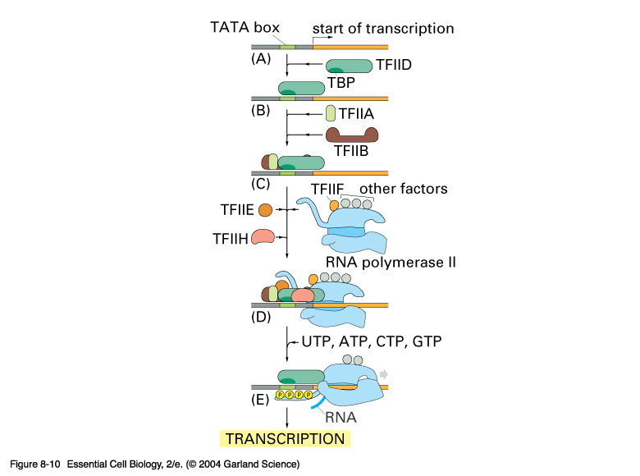
Initiation
* The 1st step is binding of TFII D to TATA box, then binding of other factors & RNA polymerase II → pre-initiation complex.
* Enz. phosphorylation by specific kinase activates RNA pol. & separates all TFII except D & F.
*Then transcription starts ~25 bp downstream of TATA box at (+1).
* TF (transcription factor)

Slide 17
Elongation
Resemble that of prok. but helped by elongation factors (phosphorylation)
Termination
A specific termination sequence (AAUAAA) at 100-1000 base downstream of the gene is recognized by endonuclease, then the enz. is dephosphorylated & separated from TFII-F.
Termination occurs at varying distances from gene end.

Slide 18
Eukaryotes | Prokaryotes | Points
Several (I, II, III & mitochond.) | One type | RNA polymerase
Monocistronic | Polycistronic | mRNA
TATA (25-35 n up+1) CAT box & GC box (40-200n up+1) | TATA box (10 n up +1) TTGACA box (35 n up +1) | Boxes at promotor | Initiation
By TFII transcription factors | By sigma factor | TATA box recognit.
Elongation factors | No elongation factors | Elongation
Endonuclease dephosphorylates E | Rho depend. & Rho-independ (hairpin) | Termination
α-amantin | Rifampicin | Inhibition
Extensive | Limited | Post-transcript. modificat.

Slide 19
Post-transcription modifications
Prokary. mRNA is generally identical to its 1^{ry} transcript, but eukary. mRNA is extensively modified post-transcriptionally.
Processing of eukaryotic mRNA
mRNA
capping‘5
3' polyA tail
Intron excision
Exon splicing

Slide 20
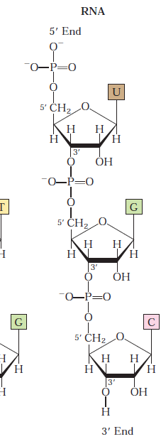
Unusual 5'→ 5' triphosphate link
Capping
5’-End
3’-End
7-Methylguanosine
triphosphate cap
Poly-A tail
Importance:
1. It protects the 5' end of mRNA from exonucleases.
2. It helps the initiation of protein synthesis.
3. Eukary. mRNA lacking cap are not efficiently translated.

Slide 21
Poly A tail
Adding poly- A tail at the 3' end of mRNA (100-200 Adenine). It is not transcribed from DNA but added after transcription by polyadenylate polymerase using ATP as a substrate.
Importance:
1. It protects mRNA from exonucleases.
2. It facilitate their exit from the nucleus. After the mRNA enters the cytosol, the poly-A tail is gradually shortened.

Slide 22
Splicing: (Removal of introns & joining of exons)
by splicesomes [small nuclear ribonucleoprotein]
└ (snRNA & proteins) (RNA enzyme; ribozymes) ┘
recognize exon-intron junctions by specific sequences inbetween
Advantage of having genes in exons & introns:
Coding for different proteins by alternative splicing (IG).
Decreasing possibility of effective mutations if in introns
Clinical significance:
15% of all genetic diseases are due to mutations RNA splicing
Effect of splice site mutations:
Improper splicing & abnormal protein production
(e.g. defective β-globin in β−thalassemia).
2. Exons being skipped (removed) or introns retained.

Slide 23
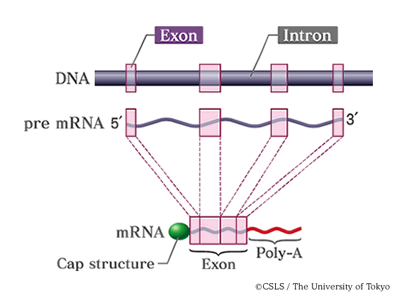
Post-transcriptional modification of mRNA

Slide 24
Post-transcriptional modification of rRNA
rRNA of both pro- & eukaryotes is synthesized from long precursor (pre-rRNAs).
Prok. pre-rRNAs 23S, 16S & 5S rRNA
Euk. pre-rRNAs 28S, 18S & 5.8S rRNA
*Euk. 5S rRNA is synthesized by RNA polymerase III
Cleavage by
Ribonucleases
Cleavage by
Ribonucleases

Slide 25
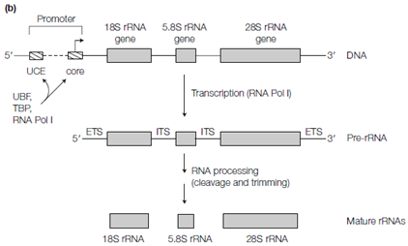
Post-transcriptional modification of Eukary. rRNA

Slide 26
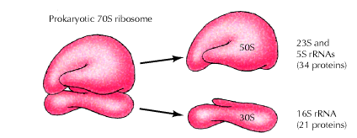
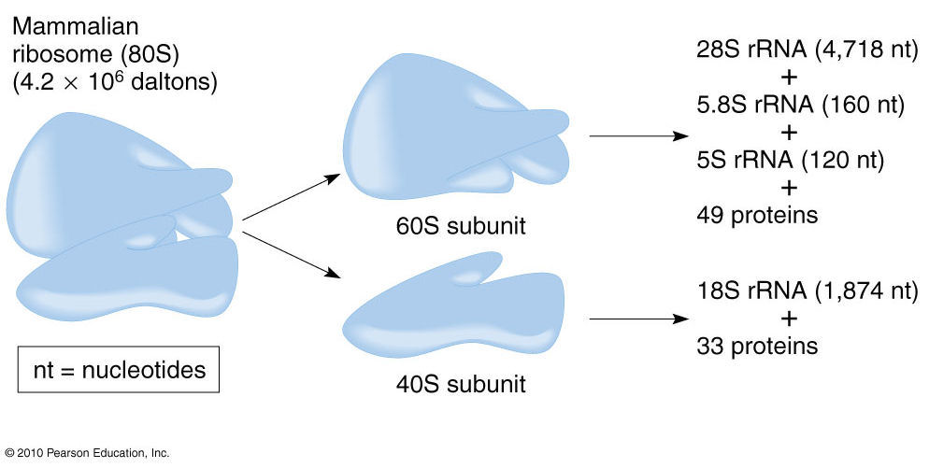
Vh
Bnn
,.l
jj
a
a
h

Slide 27
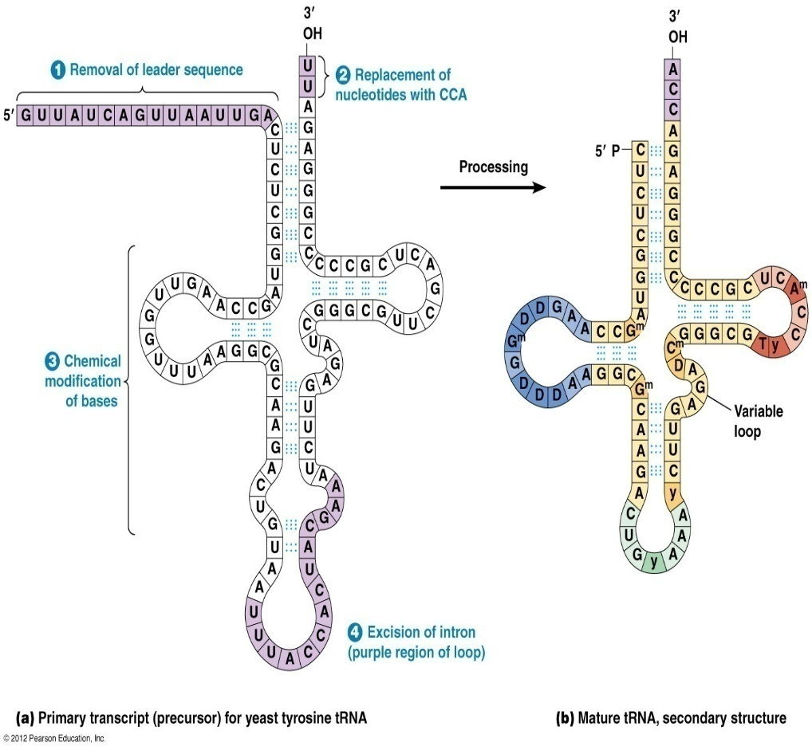
Post-transcriptional modification of tRNA
Excis. 5' end nucleotides
Add. 3' end CCA
*Methyl. (U→T)
**Reduct.
(U→DHU)
**
**
*
*
***Pseudouracil formation.
in anticodon loop

Slide 28
Reverse transcription: generation of complement. DNA (cDNA) from RNA template by Reverse transcriptase (RT); as in:
a. Replicat. of retroviruses (HIV); RT inhibitors are antiretroviral
b. Replicat. of chromosomal ends (telomerase).
Retroviral RT has 3 sequential biochemical activities:
1. RNA-dependent DNA polymerase
2. Ribonuclease H (digest RNA strand of RNA-DNA heteroduplex)
3. DNA-dependent DNA polymerase
?
N.B. Retrovirus RNA (SS) → cDNA integrate into host genome,
making infection very difficult to eradicate.
In lab: RNA→cDNA: cloning, sequencing, PCR, or genome analysis

Slide 29
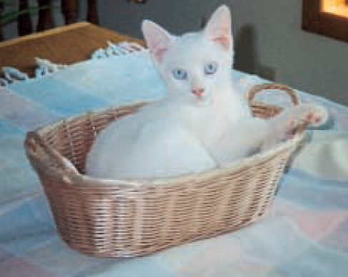
thank you
Shuzan Ali
4/10/2016 8:52 AM
shuzan.ali@fmed.bu.edu.eg
29

